Slide 1



Industrial Storm Water Employee Training
*Not a recommendation to utilize any specific vendors/products. This is also not an exhaustive list of available relevant training – consider it a “starter kit” with several resources to investigate.

Slide 2
Objectives
What are ‘Qualified Personnel’?
Why do we need ‘Qualified Personnel’?
EPA & DEQ Employee Training Requirements
Relevant excerpts from the OKR05 MSGP
Training resources, slides 25+
A pre-recorded version of this presentation will be available at www.okc.gov/SWQ

Slide 3

What are ‘Qualified Personnel’
And why do we need them?

Slide 4
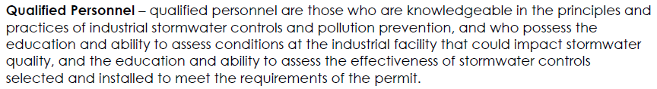
What are ‘Qualified Personnel’
EPA (2015 MSGP) and DEQ (2017 MSGP) OKR05 definition of qualified personnel:
Notes:
EPA: https://www.epa.gov/npdes/stormwater-discharges-industrial-activities
DEQ: https://www.deq.ok.gov/water-quality-division/wastewater-stormwater/stormwater-permitting/okr05-industrial-stormwater/

Slide 5
Why do we need ‘Qualified Personnel’?
4.1 Stormwater Pollution Prevention Plan Requirements
The SWP3 shall be prepared in accordance with good engineering practices and to industry standards. The SWP3 may be developed by either a person on your staff or a third party you hire, but it must be developed by a qualified person and must be certified per the signature requirements in Part 9.16….
Note: A qualified person is a person who is knowledgeable in the principles and practices of industrial stormwater controls and pollution prevention, and possesses the education and ability to assess conditions at the industrial facility that could impact stormwater quality, as well as the education and ability to assess the effectiveness of stormwater controls selected and installed to meet the requirements of the permit.
4.2.5.4 Pertaining to Monitoring
Note: A qualified person (as defined in Part 10 of this Permit) must be responsible for all types of facility inspections, corrective action determination and documentation, and all types of monitoring required by this Permit.
5.1 Routine Facility Inspections
Inspections must be performed by qualified personnel (as defined in Part 10) with at least one member of your stormwater pollution prevention team participating. Inspectors must consider the results of visual and analytical monitoring (if any) for the past year when planning and conducting inspections.
Notes:
https://www.deq.ok.gov/water-quality-division/wastewater-stormwater/stormwater-permitting/okr05-industrial-stormwater/

Slide 6
Why do we need ‘Qualified Personnel’?
9.16.4 Certification
Any person signing documents in accordance with Part 9.16 must include the following certification:
“I certify under penalty of law that this document and all attachments were prepared under my direction or supervision in accordance with a system designed to assure that qualified personnel properly gathered and evaluated the information contained therein. Based on my inquiry of the person or persons who manage the system, or those persons directly responsible for gathering the information, the information contained is, to the best of my knowledge and belief, true, accurate, and complete. I am aware that there are significant penalties for submitting false information, including the possibility of fine and imprisonment for knowing violations.”
SWP3 = Storm Water Pollution Prevention Plan
Notes:
https://www.deq.ok.gov/water-quality-division/wastewater-stormwater/stormwater-permitting/okr05-industrial-stormwater/

Slide 7


EPA & DEQ Employee Training Requirements
www.epa.gov/npdes/stormwater-discharges-industrial-activities
www.deq.ok.gov/water-quality-division/wastewater-stormwater/stormwater-permitting/okr05-industrial-stormwater/
From each agency’s Industrial Multi-Sector General Permit

Slide 8
EPA 2015 MSGP – Employee Training Requirements
2.1.2.8 Employee Training. You must train all employees who work in areas where industrial materials or activities are exposed to stormwater, or who are responsible for implementing activities necessary to meet the conditions of this permit (e.g., inspectors, maintenance personnel), including all members of your stormwater pollution prevention team. You must ensure the following personnel understand the requirements of this permit and their specific responsibilities with respect to those requirements:
  Personnel who are responsible for the design, installation, maintenance, and/or repair of controls (including pollution prevention measures);
  Personnel responsible for the storage and handling of chemicals and materials that could become contaminants in stormwater discharges;
  Personnel who are responsible for conducting and documenting monitoring and inspections as required in Parts 3 and 6; and
  Personnel who are responsible for taking and documenting corrective actions as required in Part 4.
  Personnel must be trained in at least the following if related to the scope of their job duties (e.g., only personnel responsible for conducting inspections need to understand how to conduct inspections):
  An overview of what is in the SWPPP;
  Spill response procedures, good housekeeping, maintenance requirements, and material management practices;
  The location of all controls on the site required by this permit, and how they are to be maintained;
  The proper procedures to follow with respect to the permit’s pollution prevention requirements; and
  When and how to conduct inspections, record applicable findings, and take corrective actions.
Notes:
www.epa.gov/npdes/stormwater-discharges-industrial-activities

Slide 9
DEQ 2017 MSGP OKR05 – Employee Training Requirements
3.1.2.8 Employee Training
You must train all employees who work in areas where industrial materials or activities are exposed to stormwater, or who are responsible for implementing activities necessary to meet the conditions of this Permit (e.g., inspectors, maintenance personnel), including all members of your stormwater pollution prevention team.
You must ensure the following personnel understand the requirements of this Permit and their specific responsibilities with respect to those requirements:
  Personnel who are responsible for the design, installation, maintenance, and/or repair of controls (including pollution prevention measures);
  Personnel who are responsible for the storage and handling of chemicals and materials that could become contaminants in stormwater discharges;
  Personnel who are responsible for conducting and documenting inspections and monitoring as required in Part 5 and Part 7; and
  Personnel who are responsible for taking and documenting corrective actions as required in Part 6.
Personnel must be trained in at least the following if related to the scope of their job duties (e.g., only personnel responsible for conducting inspections need to understand how to conduct inspections):
  An overview of what is in the SWP3;
  Spill response procedures, good housekeeping, maintenance requirements, and material management practices;
  The location of all controls on the site required by this Permit, and how they are to be maintained;
  The proper procedures to follow with respect to the permit’s pollution prevention requirements; and
  When and how to conduct inspections, record applicable findings, and take corrective actions.
Employee training must be conducted at least annually or more frequently if employee turnover is high.
Notes:
www.deq.ok.gov/water-quality-division/wastewater-stormwater/stormwater-permitting/okr05-industrial-stormwater/

Slide 10

Relevant excerpts from the OKR05
2017 OKR05, Industrial Multi-Sector General Permit for Oklahoma
www.deq.ok.gov/water-quality-division/wastewater-stormwater/stormwater-permitting/okr05-industrial-stormwater/

Slide 11
DEQ 2017 Industrial MSGP OKR05 – General Requirements, excerpts
3.1.2.3 Preventive Maintenance
You must maintain all control measures that are used to achieve the effluent limits in this Permit in effective operating condition, as well as all industrial equipment and systems, in order to minimize pollutant discharges. This includes:
  …Diligently maintaining non-structural control measures (e.g., keep spill response supplies available, personnel appropriately trained).…
3.1.2.4 Spill Prevention and Response
  Develop training on the procedures for expeditiously stopping, containing, and cleaning up leaks, spills, and other releases. As appropriate, execute such procedures as soon as possible;
Notes:
www.deq.ok.gov/water-quality-division/wastewater-stormwater/stormwater-permitting/okr05-industrial-stormwater/

Slide 12
DEQ 2017 Industrial MSGP OKR05 – General Requirements, excerpts
3.1.2.8 Employee Training
You must train all employees who work in areas where industrial materials or activities are exposed to stormwater, or who are responsible for implementing activities necessary to meet the conditions of this Permit (e.g., inspectors, maintenance personnel), including all members of your stormwater pollution prevention team.
You must ensure the following personnel understand the requirements of this Permit and their specific responsibilities with respect to those requirements:
  Personnel who are responsible for the design, installation, maintenance, and/or repair of controls (including pollution prevention measures);
  Personnel who are responsible for the storage and handling of chemicals and materials that could become contaminants in stormwater discharges;
  Personnel who are responsible for conducting and documenting inspections and monitoring as required in Part 5 and Part 7; and
  Personnel who are responsible for taking and documenting corrective actions as required in Part 6.
Personnel must be trained in at least the following if related to the scope of their job duties (e.g., only personnel responsible for conducting inspections need to understand how to conduct inspections):
  An overview of what is in the SWP3;
  Spill response procedures, good housekeeping, maintenance requirements, and material management practices;
  The location of all controls on the site required by this Permit, and how they are to be maintained;
  The proper procedures to follow with respect to the permit’s pollution prevention requirements; and
  When and how to conduct inspections, record applicable findings, and take corrective actions.
Employee training must be conducted at least annually or more frequently if employee turnover is high.
Notes:
https://www.deq.ok.gov/water-quality-division/wastewater-stormwater/stormwater-permitting/okr05-industrial-stormwater/

Slide 13
DEQ 2017 Industrial MSGP OKR05 – General Requirements, excerpts
4.2.1 Stormwater Pollution Prevention Team
You must identify the staff members (by name and/or title) who comprise the facility’s stormwater pollution prevention team, as well as their individual roles and responsibilities. Your stormwater pollution prevention team is responsible for overseeing development of the SWP3, any modifications to it, and for implementing and maintaining control measures and taking corrective actions when required, performing routine facility inspections and monitoring, supervising the housekeeping program, documenting changes to the SWP3, providing staff training, and communicating changes in the SWP3 to the people working on the site. Each member of the stormwater pollution prevention team must have ready access to either an electronic or paper copy of applicable portions of this Permit, the most updated copy of your SWP3, and other relevant documents or information that must be kept with the SWP3.
Notes:
https://www.deq.ok.gov/water-quality-division/wastewater-stormwater/stormwater-permitting/okr05-industrial-stormwater/

Slide 14
DEQ 2017 Industrial MSGP OKR05 – General Requirements, excerpts
4.2.5.1 Pertaining to Control Measures Used to Comply with the Effluent Limits in Part 3
The following must be documented in your SWP3:
  g. Employee Training (see Part 3.1.2.8) – The elements of your employee training plan shall include all, but not be limited to, the requirements set forth in Part 3.1.2.8, and also the following:
    The content of the training;
    The frequency/schedule of training for employees who work in areas where industrial materials or activities are exposed to stormwater, or who are responsible for implementing activities necessary to meet the conditions of this permit;
    A log of the dates on which specific employees received training.
Employee training shall be conducted at least annually (or more often if employee turnover is high).
Notes:
https://www.deq.ok.gov/water-quality-division/wastewater-stormwater/stormwater-permitting/okr05-industrial-stormwater/

Slide 15
DEQ 2017 Industrial MSGP OKR05 – Sector Specific Requirements, excerpts
Sector G: Metal Mining
G.6.1 Employee Training
Conduct employee training at least annually at active and temporarily Inactive facilities. (See also Part 3.1.2.8.)
G.7.5 Employee Training
All employee trainings must be documented this in the SWP3. (See also Part 3.1.2.8.)
Notes:
https://www.deq.ok.gov/water-quality-division/wastewater-stormwater/stormwater-permitting/okr05-industrial-stormwater/

Slide 16
DEQ 2017 Industrial MSGP OKR05 – Sector Specific Requirements, excerpts
Sector J: Mineral Mining and Dressing
J.5.1 Employee Training
Conduct employee training at least annually at active and temporarily inactive facilities. (See also Part 3.1.2.8.)
J.7.5 Employee Training
All employee training(s) conducted in accordance with Part 11.J.5.1 must be documented with the SWP3.
Notes:
https://www.deq.ok.gov/water-quality-division/wastewater-stormwater/stormwater-permitting/okr05-industrial-stormwater/

Slide 17
DEQ 2017 Industrial MSGP OKR05 – Sector Specific Requirements, excerpts
Sector M: Automobile Salvage Yards
M.3.2 Employee Training
If applicable to your facility, address the following areas (at a minimum) in your employee training program: proper handling (collection, storage, and disposal) of oil, used mineral spirits, anti-freeze, mercury switches, and solvents. (See also Part 3.1.2.8.)
Notes:
https://www.deq.ok.gov/water-quality-division/wastewater-stormwater/stormwater-permitting/okr05-industrial-stormwater/

Slide 18
DEQ 2017 Industrial MSGP OKR05 – Sector Specific Requirements, excerpts
Sector N: Scrap Recycling and Waste Recycling Facilities
N.4.1 Scrap and Waste Recycling Facilities (Non-source Separated, Non-liquid Recyclable Materials)
a. Inbound Recyclable and Waste Material Control Program: Minimize the chance of accepting materials that could be significant sources of pollutants by conducting inspections of inbound recyclables and waste materials and through implementation of control measures such as the following, where determined to be feasible (list not exclusive): providing information and education to suppliers of scrap and recyclable waste materials on draining and properly disposing of residual fluids (e.g., from vehicles and equipment engines, radiators and transmissions, oil filled transformers, and individual containers or drums) and removal of mercury switches from vehicles before delivery to your facility; establishing procedures to minimize the potential of any residual fluids from coming into contact with precipitation or runoff; establishing procedures for accepting scrap lead-acid batteries (additional requirements for the handling, storage, and disposal or recycling of batteries are contained in the scrap lead-acid battery program provisions in Part 11.N.4.1.f); providing training targeted for those personnel engaged in the inspection and acceptance of inbound recyclable materials; and establishing procedures to ensure that liquid wastes, including used oil, are stored in materially compatible and non-leaking containers and are disposed of or recycled in accordance with the Resource Conservation and Recovery Act (RCRA).
f. Scrap Lead-Acid Battery Program: To minimize the discharge of pollutants in stormwater from lead-acid batteries, properly handle, store, and dispose of scrap lead-acid batteries, and implement control measures such as the following, where determined to be feasible (list not exclusive): segregating scrap lead-acid batteries from other scrap materials; properly handling, storing, and disposing of cracked or broken batteries; collecting and disposing of leaking lead-acid battery fluid; minimizing or eliminating (if possible) exposure of scrap lead-acid batteries to precipitation or runoff; and providing employee training for the management of scrap batteries.
Notes:
https://www.deq.ok.gov/water-quality-division/wastewater-stormwater/stormwater-permitting/okr05-industrial-stormwater/

Slide 19
DEQ 2017 Industrial MSGP OKR05 – Sector Specific Requirements, excerpts
N.4.3 Recycling Facilities (Source-Separated Materials)
  a. Inbound Recyclable Material Control: Minimize the chance of accepting non-recyclables (e.g., hazardous materials) that could be a significant source of pollutants by conducting inspections of inbound materials and through the implementation of control measures such as the following, where determined to be feasible (list not exclusive): providing information and education measures to inform suppliers of recyclables about acceptable and non-acceptable materials; training drivers responsible for pickup of recycled material; clearly marking public drop-off containers regarding which materials can be accepted; rejecting non-recyclable wastes or household hazardous wastes at the source; and establishing procedures for handling and disposal of non-recyclable material.
  c. Indoor Storage and Material Processing: Minimize the release of pollutants from indoor storage and processing areas through implementation of control measures such as the following, where determined to be feasible (list not exclusive): scheduling routine good housekeeping measures for all storage and processing areas; prohibiting tipping floor wash water from draining to the storm sewer system; and providing employee training on pollution prevention practices.
  d. Vehicle and Equipment Maintenance: Minimize the discharge of pollutants in stormwater from areas where vehicle and equipment maintenance occur outdoors through implementation of control measures such as the following, where determined to be feasible (list not exclusive): minimizing or eliminating outdoor maintenance areas; establishing spill prevention and clean-up procedures in fueling areas; avoiding topping off fuel tanks; diverting runoff from fueling areas; storing lubricants and hydraulic fluids indoors; and providing employee training on proper handling and storage of hydraulic fluids and lubricants.
Notes:
https://www.deq.ok.gov/water-quality-division/wastewater-stormwater/stormwater-permitting/okr05-industrial-stormwater/

Slide 20
DEQ 2017 Industrial MSGP OKR05 – Sector Specific Requirements, excerpts
Sector P: Land Transportation and Warehousing
P.4.2 Employee Training
Train personnel at least once a year and address the following activities, as applicable: used oil and spent solvent management; fueling procedures; general good housekeeping practices; proper painting procedures; and used battery management. (See also Part 3.1.2.8.)
Sector Q: Water Transporation
Q.4.2 Employee Training
As part of your employee training program, address, at a minimum, the following activities (as applicable): used oil management; spent solvent management; disposal of spent abrasives; disposal of vessel wastewaters; spill prevention and control; fueling procedures; general good housekeeping practices; painting and blasting procedures; and used battery management. (See also Part 3.1.2.8.)
Notes:
https://www.deq.ok.gov/water-quality-division/wastewater-stormwater/stormwater-permitting/okr05-industrial-stormwater/

Slide 21
DEQ 2017 Industrial MSGP OKR05 – Sector Specific Requirements, excerpts
Sector R: Ship and Boat Building or Repair Yards
R.4.2 Employee Training
As part of your employee training program, address, at a minimum, the following activities (as applicable): used oil management, spent solvent management, disposal of spent abrasives, disposal of vessel wastewaters, spill prevention and control, fueling procedures, general good housekeeping practices, painting and blasting procedures, and used battery management. (See also Part 3.1.2.8.)
Sector T: Treatment Works
T.4.2 Employee Training
At a minimum, training must address the following areas when applicable to a facility: petroleum product management; process chemical management; spill prevention and controls; fueling procedures; general good housekeeping practices; and proper procedures for using fertilizer, herbicides, and pesticides. (See also Part 3.1.2.8.)
Sector U: Food and Kindred Products
U.4 Additional Technology-Based Limitations
Employee Training (see also Part 3.1.2.8): Address pest control in your employee training program.
Notes:
https://www.deq.ok.gov/water-quality-division/wastewater-stormwater/stormwater-permitting/okr05-industrial-stormwater/

Slide 22
DEQ 2017 Industrial MSGP OKR05 – Sector Specific Requirements, excerpts
Sector V: Textile Mills, Apparel and Other Fabric Products
V.4.2 Employee Training
As part of your employee training program, address, at a minimum, the following activities (as applicable): use of reused and recycled waters, solvents management, proper disposal of dyes, proper disposal of petroleum products and spent lubricants, spill prevention and control, fueling procedures, and general good housekeeping practices. (See also Part 3.1.2.8.)
Sector X: Printing and Publishing
X.4 Employee Training
As part of your employee training program, address, at a minimum, the following activities (as applicable): spent solvent management, spill prevention and control, used oil management, fueling procedures, and general good housekeeping practices. (See also Part 3.1.2.8.)
Notes:
https://www.deq.ok.gov/water-quality-division/wastewater-stormwater/stormwater-permitting/okr05-industrial-stormwater/

Slide 23
DEQ 2017 Industrial MSGP OKR05 – Sector Specific Requirements, excerpts
Sector Y: Rubber, Miscellaneous Plastic Products and Miscellaneous Manufacturing Industries
Y.3.1 Controls for Rubber Manufacturers
  a. Zinc Bags: Ensure proper handling and storage of zinc bags at your facility through implementation of control measures such as the following, where determined to be feasible (list not exclusive): employee training on the handling and storage of zinc bags; indoor storage of zinc bags; cleanup of zinc spills without washing the zinc into the storm drain; and the use of 2,500-pound sacks of zinc rather than 50- to 100-pound sacks.
Notes:
https://www.deq.ok.gov/water-quality-division/wastewater-stormwater/stormwater-permitting/okr05-industrial-stormwater/

Slide 24
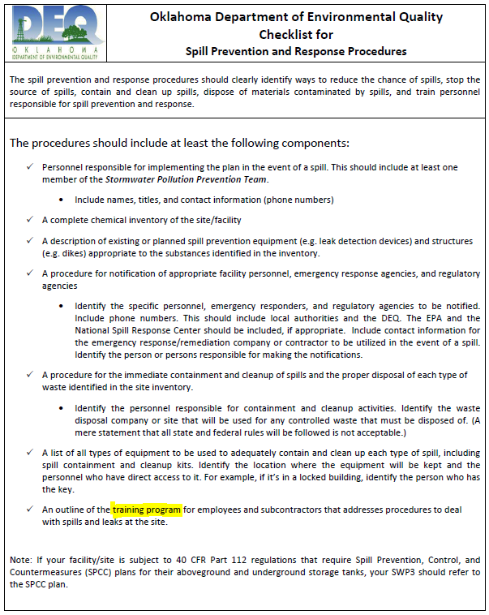
DEQ Checklist for Spill Prevention and Response Procedures
OKR05 Appendix G
Oklahoma Department of Environmental Quality Checklist for Spill Prevention and Response Procedures
The procedures should include at least the following components:
  An outline of the training program for employees and subcontractors that addresses procedures to deal with spills and leaks at the site.
Notes:
https://www.deq.ok.gov/water-quality-division/wastewater-stormwater/stormwater-permitting/okr05-industrial-stormwater/

Slide 25

Training Resources
Industrial Storm Water Employee Training
*Not a recommendation to utilize any specific vendors/products. This is also not an exhaustive list of available relevant training – consider it a “starter kit” with several resources to investigate.

Slide 26
Websites
United States EPA, NPDES, Industrial Stormwater
  www.epa.gov/npdes/stormwater-discharges-industrial-activities
Oklahoma DEQ, Industrial Stormwater (OKR05)
  www.deq.ok.gov/water-quality-division/wastewater-stormwater/stormwater-permitting/okr05-industrial-stormwater/
City of Oklahoma City, Public Works, Storm Water Quality Management
  www.okc.gov/departments/public-works/divisions/storm-water-quality
  Shortcut: www.okc.gov/SWQ

Slide 27
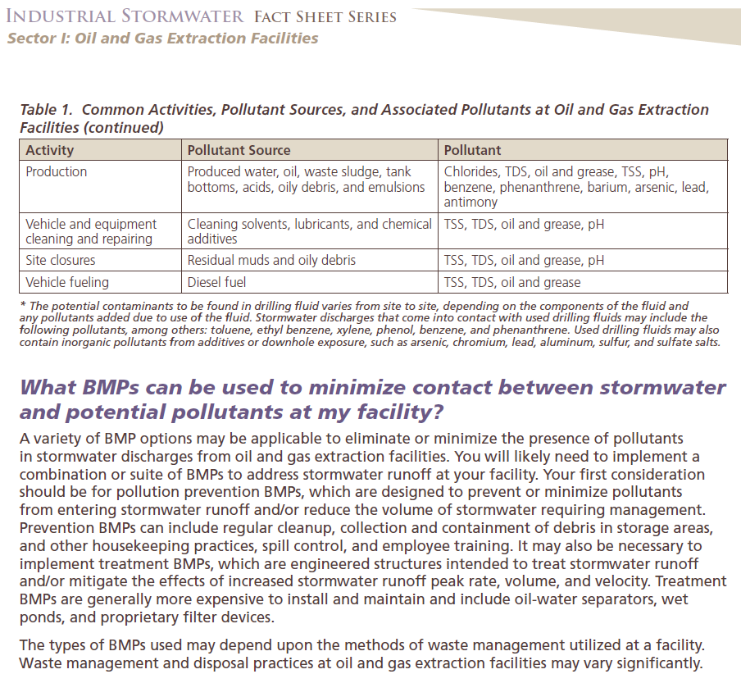
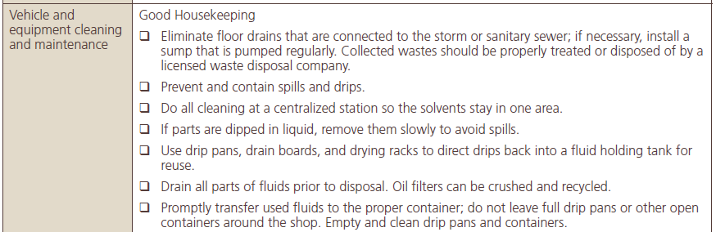
EPA Sector-Specific Guides
Train employees on sector-specific Best Management Practices
www.epa.gov/npdes/industrial-stormwater-fact-sheet-series
Example: Excerpts from Sector I: Oil and Gas Extraction Facilities
Notes:
https://www.epa.gov/npdes/industrial-stormwater-fact-sheet-series

Slide 28
Videos*
ERI Safety Videos www.erisafetyvideos.com (Category: EPA Compliance)
  “Understanding Your Facility’s Stormwater Pollution Prevention Plan” $495
  “Stormwater Pollution Prevention Plan General Awareness Training” $275
Excal Visual www.excalvisual.com (Stormwater)
  “Stormwater Pollution Prevention: A Drop in the Bucket” $495
  “Storm Warnings – Stormwater Pollution Prevention” $495
  “Concrete Wash-Out Video Training ‘Building for a Cleaner Environment’” $395
Google “Stormwater Training Video” for additional links and resources, including links to YouTube videos. Check out StormTV Project’s playlist:
  www.youtube.com/playlist?list=PL4C55204EF5052D5B
*Not a recommendation to utilize any specific vendors/products.
Notes:
*Not a recommendation to utilize any specific vendors/products. Also not an exhaustive list of available relevant training – merely a “starter kit” and several resources to investigate.

Slide 29
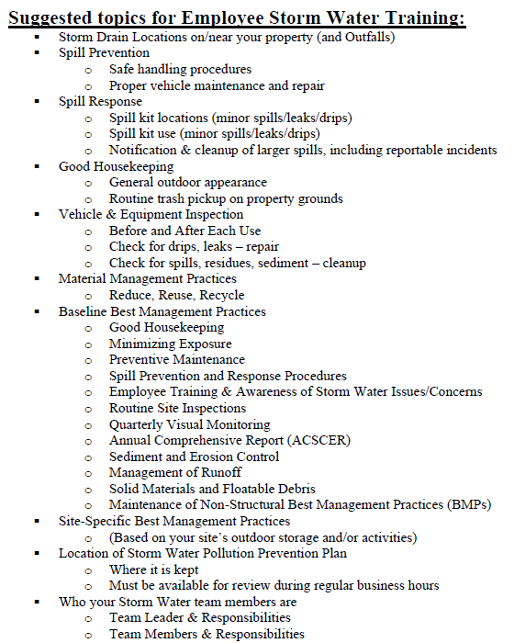
Training topic suggestions from your own SWP3
An older version of this guide is available on previous workshop CDs. Ask your inspector for an updated copy.

Slide 30

OKC Industrial Storm Water,
Free Training Offered:
Annual workshop event, two sessions offered, typically in May
  Live event, many subjects covered by OKC SWQ Staff
  Guest speakers
  Vendors, networking opportunities
Quarterly webinars
  New program starting in 2020
  www.okc.gov/SWQ for playback of previously recorded webinars (including this one)
Quarterly Lunch-n-Learn events
  New program starting in 2020
  Vendor-sponsored, learn what products and services local vendors can provide to help keep your facility in compliance with SWQ rules and regulations
Be sure you’re on our email list in order to receive registration information for these training opportunities!

Slide 31

Local entities providing Storm Water employee training*
Oklahoma Water Survey, University of Oklahoma
  www.ou.edu/okh2o
  Workshops and training available
  Email: outreach@OKH2O.org for more information
Francis Tuttle Business & Industry Services
  Safety Awareness Training Topics include: “Stormwater Runoff”
  Contact Robert Aldridge at 405.717.4761 for more information
Check with other local colleges/universities to see what they offer
Environmental Consulting Firms may also provide training
*Not a recommendation to utilize any specific vendors/products.
Notes:
*Not a recommendation to utilize any specific vendors/products. Also not an exhaustive list of available relevant training – merely a “starter kit” and several resources to investigate.

Slide 32
One of the BEST resources: Our Team!
Be sure to get with our local storm water quality staff to match your needs with our resources and experience!
  Call 405-297-1774 (main office)
  www.okc.gov/SWQ for additional contacts and information
Your inspector can provide mini training sessions, and/or provide guidance in the development of your own training program.
The Industrial Section Supervisor and Storm Water Community Relations Coordinator are also available to provide training and participate in your Earth Day events or employee fairs.

Slide 33
OKC Industrial Storm Water Inspector tips on training:
Look through your site’s Storm Water Pollution Prevention Plan (SWP3), there’s plenty of material to cover in there!
Site-specific Best Management Practices
Emergency spill procedures and spill kit locations
Process water (industrial wastewater) vs. Storm Water
Labeling containers stored outdoors, to quickly ID in case of spill or leak
Good Housekeeping & routine trash pickup, including along fence lines
Chemical storage areas: covered/sealed and inspected regularly
Don’t dump mop water outside
Don’t store batteries nor leaking equipment outside, where possible
Include training in your New Hire Orientation program
*Some of these suggestions can have certain exceptions, based on circumstances at the time of inspection.
Do what works for your site to prevent polluted storm water runoff!

Slide 34
OKC Industrial Storm Water Inspector tips on training:
What format?
  No required format
    Tailgate meeting
    In-house generated presentation
    Utilize resources/presentations from Workshop CD/OKC Website
How long?
  No required length
    As long as it takes to convey your message
Who do we train?
  Anyone who works outside or could observe a potential storm water concern
  “Everyone” can learn spill reporting procedures & litter prevention
The main thing: DOCUMENTATION of Storm Water related training

Slide 35

For more information:
www.okc.gov/SWQ
www.deq.ok.gov
www.epa.gov
Notes:
Image credit: Getty Images

Slide 36
For more information:
www.okc.gov/SWQ
www.deq.ok.gov
www.epa.gov
Notes:
Image credit: Getty Images

